Slide 1

Problem #142 ·Horror Text Adventure Game
By Raj Bharat Rasal

Slide 2
Problem Statement
Most browser-based text adventure games fail to create genuine immersion. They use static UIs, cosmetic choices, and lack any sense of real consequence or threat. Players disengage quickly.
There is no structured progression system — no health or sanity mechanics, no meaningful branching, no score tracking, and no way to replay with different outcomes.
The objective is to design and build a responsive Horror Text Adventure Game in HTML-5, CSS, and JavaScript — featuring interactive decision paths, health/sanity stats, multiple endings, and a leaderboard with localStorage integration.
HTML-5 · CSS3 · JavaScript · No Framework · No Server

Slide 3
Solution
How It Solves the Problem
Immersive UI: crimson-on-black design, animated tarot card choices, typewriter prose
Real consequence: Dread/Safety stats shift with every decision and determine which ending the player reaches
Structured progression: 4 chapters with chapter splash transitions and escalating tension
Score tracking: final score calculated from Safety level, inverse Dread, and chapter reached
Leaderboard: persistent across browser sessions using localStorage key knock_once_v3
Zero dead ends: all 40+ node references validated — every path resolves to a valid ending
What Was Built
A single-page browser application set in a Mumbai apartment at 11:00 PM
Player receives three knocks at the door — every choice they make drives two hidden stats: Dread (0–100) and Safety (0–100)
4 Chapters · 40+ Story Nodes · 9 Unique Endings (4 good, 5 bad)
30-second countdown timer per choice — auto-selects on timeout (panic mechanic)
Player's full name entered at start and spoken by the entity mid-story — personalised horror
Evil-eye chapter splash screens with full-bleed background image
4-track randomised horror audio playlist that loops for the game's full duration
localStorage leaderboard — scores and outcomes saved across sessions

Slide 4
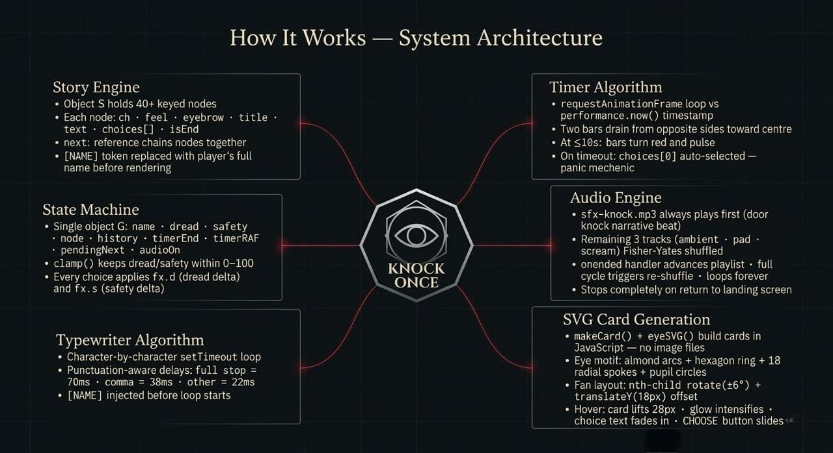
How It Works

Slide 5
Conclusion
Problem solved: KNOCK ONCE fully delivers on ITM Skills University Problem Statement #142. It is a responsive, browser-based horror adventure with branching decision paths, Dread/Safety health mechanics, nine unique endings, score tracking, and a localStorage leaderboard — all built with HTML-5, CSS3, and Vanilla JavaScript exactly as required.
Beyond the brief: The project goes further than the minimum requirements. It adds full-name personalisation (the entity speaks the player's own name), a programmatic SVG tarot card system, a punctuation-aware typewriter engine, a Fisher-Yates shuffled four-track audio playlist with narrative ordering, an evil-eye animated chapter splash, and a 30-second panic timer with auto-select on timeout.
What it demonstrates: KNOCK ONCE proves that a production-quality, atmosphere-driven interactive experience can be built entirely within the standard browser stack — no framework, no game engine, no server. It is a self-contained showcase of advanced front-end skills: state management, algorithmic animation, DOM-generated graphics, audio engineering, and narrative design — all unified in a single deployable file set.

Slide 6
Thank You

